Slide 1
NoSQL: Beyond RDBMS
COMP3211 Advanced Databases
Nicholas Gibbins and Sina Samangooei
2014-2015

Slide 2
So you have some data...
Relational Databases solve most data problems
Persistence
We can store data, and it will remain stored!
Integration
We can integrate lots of different apps through a central DB
SQL
Standard(ish), well understood, very expressive
Transactions
ACID transactions, strong consistency

Slide 3
Trends and Issues
A few key trends and issues…
…In use cases
…In technology
… have motivated change in data storage technologies
Key trends include:
Increasing volume of data and traffic
More complex data connectedness
Key Issues include:
The impedance mismatch problem

Slide 4
Impedance Mismatch
To store data persistently in modern programs:
…a single logical structure
…must be split up (The nice word is normalised)
Object Orientation
based on software engineering principals
Relational Paradigms
based on mathematics and set theory
Mapping from one world to the other has problems

Slide 5
Impedance Mismatch
Player Table
ID: 1001
USER: Steve
Player/Game
Games Played:
Date | Res | K | D | A
01/04/2009 | WIN | 20 | 2 | 10
01/05/2009 | LOOSE | 5 | 22 | 3
Games Table
Player/Team
Teams:
Team Table
Name: Killer Bee Keepers
Icon: http://imgur.com/a/...

Slide 6
Increased Data Volume
We (the world) are
… Creating, Storing, Processing…
… more data than ever before!
“From 2005 to 2020, the digital universe will grow by a factor of 300, from 130 exabytes to 40,000 exabytes, or 40 trillion gigabytes (more than 5,200 gigabytes for every man, woman, and child in 2020).
From now until 2020, the digital universe will about double every two years.”
- IDC – The Digital Universe in 2020
http://www.emc.com/leadership/digital-universe/index.htm

Slide 7
Increased Data Connectivity
The data we’re producing has fundamentally changed from
Isolated Text Documents (early 1990s)
… to html pages with links (early web)
… to blogs with ping back, RSS feeds (web 2.0)
… to social networks (… add links between people)
… to massive linked open data sets (web 3.0… one of them anyway)

Slide 8
Dealing with data size Trends
Two options when dealing with these trends:
Build Bigger Database machines
This can be expensive
Fundamental limits to machine size
Build Clusters of smaller machines
Lots of small machines (commodity machines)
Each machine is cheap, potentially unreliable
Needs a DBMS which understands clusters

Slide 9
Relational Databases suck…
RDBMS have fundamental issues
In dealing with (horizontal) scale
Designed to work on single, large machines
Difficult to distribute effectively
More subtle: An Impedance Mismatch
We create logical structures in memory
and then rip them apart to stick it in an RDBMS
The RDBMS data model often disjoint from its intended use
(Normalisation sucks sometimes)
Uncomfortable to program with (joins and ORM etc.)

Slide 10
The NoSQL Movement

Slide 11
NoSQL – A movement
NoSQL came to address
“web-scale problems”
… impedance mismatch on the way
Key attributes include:
Non-Relational (Though they can be, but aren’t good at it)
Schema Free (Except the implicit schema, application side)
Inherently Distributed (In different ways, Some more so than others)
Open Source (mostly… e.g. Oracle’s NoSQL)

Slide 12
Defining NoSQL
Quite hard to define a movement based around a negative
Is a CSV file NoSQL?
(How about a turnip?)
How about a non-relational database from the 60s/70s/80s/90s
(IMS, IDMS, MUMPS, CLOB, XMLDB etc.)
NoSQL is not definable strictly
…but many folks have certainly tried!

Slide 13
Some NoSQL Definitions
“Next Generation Databases mostly addressing some of the points: being non-relational, distributed, open-source and horizontally scalable.”
- Stefan Edlich (nosql-database.org)

Slide 14
Some NoSQL Definitions
"NoSQL: a broad class of data management systems where the data is partitioned across a set of servers, where no server plays a privileged role."
- Emin Gün Sirer (hackingdistributed.com)

Slide 15
Some NoSQL Definitions
“[To organise a meetup in the late 2000s]… you need a twitter #hashtag…That’s all #nosql was ever meant to be, a twitter hashtag to organise a single meetup at one point in time”
- Martin Fowler (goto; 2012)

Slide 16
ACID, BASE and CAP

Slide 17
ACID – A Recap
In an ideal world, database transactions should be:
Atomic
Entire transcation succeeds or the entire transactions rolls back
Consistent
A transaction must leave the database “valid” re: some defined rules
Isolated
Concurrent interactions behave as though they occurred serially
Durable
Once committed, transactions survive power loss, acts of god etc.
A big deal in traditional RDBMS

Slide 18
BASE – An alternative to ACID
A gratuitous backronym:
Basic Availability
The Application works basically all the time
Soft-state
Does not have to be consistent all the time
Eventual consistency
But will be in some known state eventually

Slide 19
The CAP Theorem – a Recap
Brewer’s CAP theorem stands for:
Consistent: writes are atomic, all subsequent requests retrieve the new value
Available: The database will always return a value so long as the server is running
Partition Tolerant: The system will still function even if the cluster network is partitioned (i.e. the cluster loses contact with parts of itself)
The overly stated well cited issue is:
Of these 3, you can only ever build an algorithm which satisfies 2
Formal Proof by Gilbert and Lynch: http://portal.acm.org/citation.cfm?doid=564585.564601

Slide 20
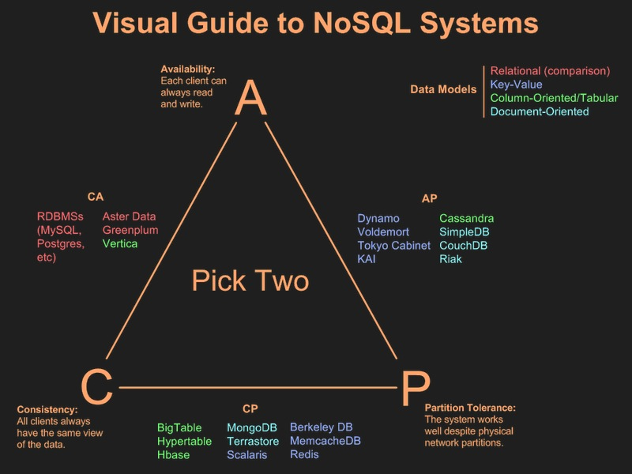
CAP Theorem – The DB perspective

Slide 21
CAP – Another Perspective
Partitions cause us to choose:
Consistency (i.e. we disallow writes during the partition)
Availability (i.e. we allow writes during a partition)

Slide 22
Eventual Consistency
A weaker form of consistency
From Amazon’s Dynamo paper:
“the storage system guarantees that if no new updates are made to the object, eventually all accesses will return the last updated value.”
Two common approaches:
MVCC
Vector Clocks

Slide 23
Multi-Version Concurrency Control
Commonly used by NoSQL document databases
Like a version control system
Writes without locks
Multiple versions of documents
Distributed Incremental Replication
Different versions on different machines
Collisions detected during replication
App developer can be informed/decide on collisions
Used by: CouchDB

Slide 24
Vector Clocks
An extension of Lamport timestamps
Represent the order of events in a distributed system
Vector clocks can be used to:
Identify the provenance of an item of data
Decide order in which data was changed
Help resolve conflicts
Flag inconsistencies for app specific decisions
Used by: Amazon’s Dynamo and Riak

Slide 25
NoSQL Databases

Slide 26
NoSQL Varieties
Key-Value stores (Amazon Dynamo)
Document Oriented (Lotus notes? Bit of a stretch! Still cool)
Column Oriented (Google’s BigTable)
Graph DBs (Triples! SPARQL!)
For a roundup checkout: http://kkovacs.eu/cassandra-vs-mongodb-vs-couchdb-vs-redis

Slide 27
Key-Value Stores – Basics
Take away message: A hashtable with persistence (sometimes, but an API at least!)
Use a key (usually a string), ask a database for a value
The value can be anything (text, structure, an image etc.)
Database often unaware of value content
… sometimes it is!

Slide 28


Key-Value Stores – Examples
Riak
Buckets/Keys/Values/Links
Query with key, process with map-reduce
Secondary Indexes (metadata)
“Loves the Web” (but they all say this)
Redis
More understanding of value types (strings, integers, lists, hashes)
In memory (very fast)

Slide 29
Document Databases – Basics
Database as storage of a mass of different documents
A document…
… is a complex data structure
… can contain completely different data from other documents
Document data stores understand their documents
Queries can run against values of document fields
Indexes can be constructed for document fields

Slide 30
Document Databases – Basics
{
"_id": "1",
"name": "steve",
"games_owned": [
{"name":"Super Meat Boy"},
{"name":"FTL"},
],
}
{
"_id": "2",
"name": "darren",
"handle":"zerocool",
"games_owned": [
{"name":“FTL"},
{"name":“Assassin’s Creed 3“, “dev”: “ubisoft”},
],
}

Slide 31


Document Databases – Examples
MongoDB
Master/Slave design
.find() queries like ORM
Geo-spatial indexing
CouchDB
Master/master
Only map reduce queries
Weird but pretty cool, see: http://sitr.us/2009/06/30/database-queries-the-couchdb-way.html
Favours availability to consistency (more on this in a bit)

Slide 32
Column Databases – Basics
Data is held in rows
Rows have keys associated
Rows contain “column families”
Column families contain the actual columns, thus data
No Schema (Columns in a family change per row)
On Querying:
Key lookup is fast
Batch processing via mapreduce
All else involves row scans

Slide 33
Column Databases – Basics
Player Details Column family
Name | “darren”
Team | “killer bee…"
… | …
SOME_KEY
game1 | <gamedata>
game2 | <gamedata>
… | …
game3 | <gamedata>
Games Column Family

Slide 34



Column Databases – Examples
Primarily for batch processing
Hbase
Uses HDFS for storage, Hadoop for processing
Built to treasure consistency over availability
Cassandra
Supports key ranges
Works over a variety of processing architectures
(Hadoop, Storm, etc.)

Slide 35
Graph Databases – Basics
Focus on modelling the data’s structure
Graphs are composed of Vertices and Edges
Vertices are connected by edges
Edges have labels and direction
Both have properties
Queried with graph traversal API or graph query language
Cypher, SPARQL
Can be much faster at querying graph like data structures
Like friends of friends or web links

Slide 36
Graph Databases – Basics
The Matrix Revolution
Acts In
Keanu Reeves
Acts In
Acts In
Acts In
The Matrix Reloaded
Laurence Fishburne
Acts In
Acts In
Acts In
Acts In
Acts In
Carrie-Anne Moss
The Matrix

Slide 37

Graph Databases – Examples
Neo4j
Not distributed
ACID transactions

Slide 38
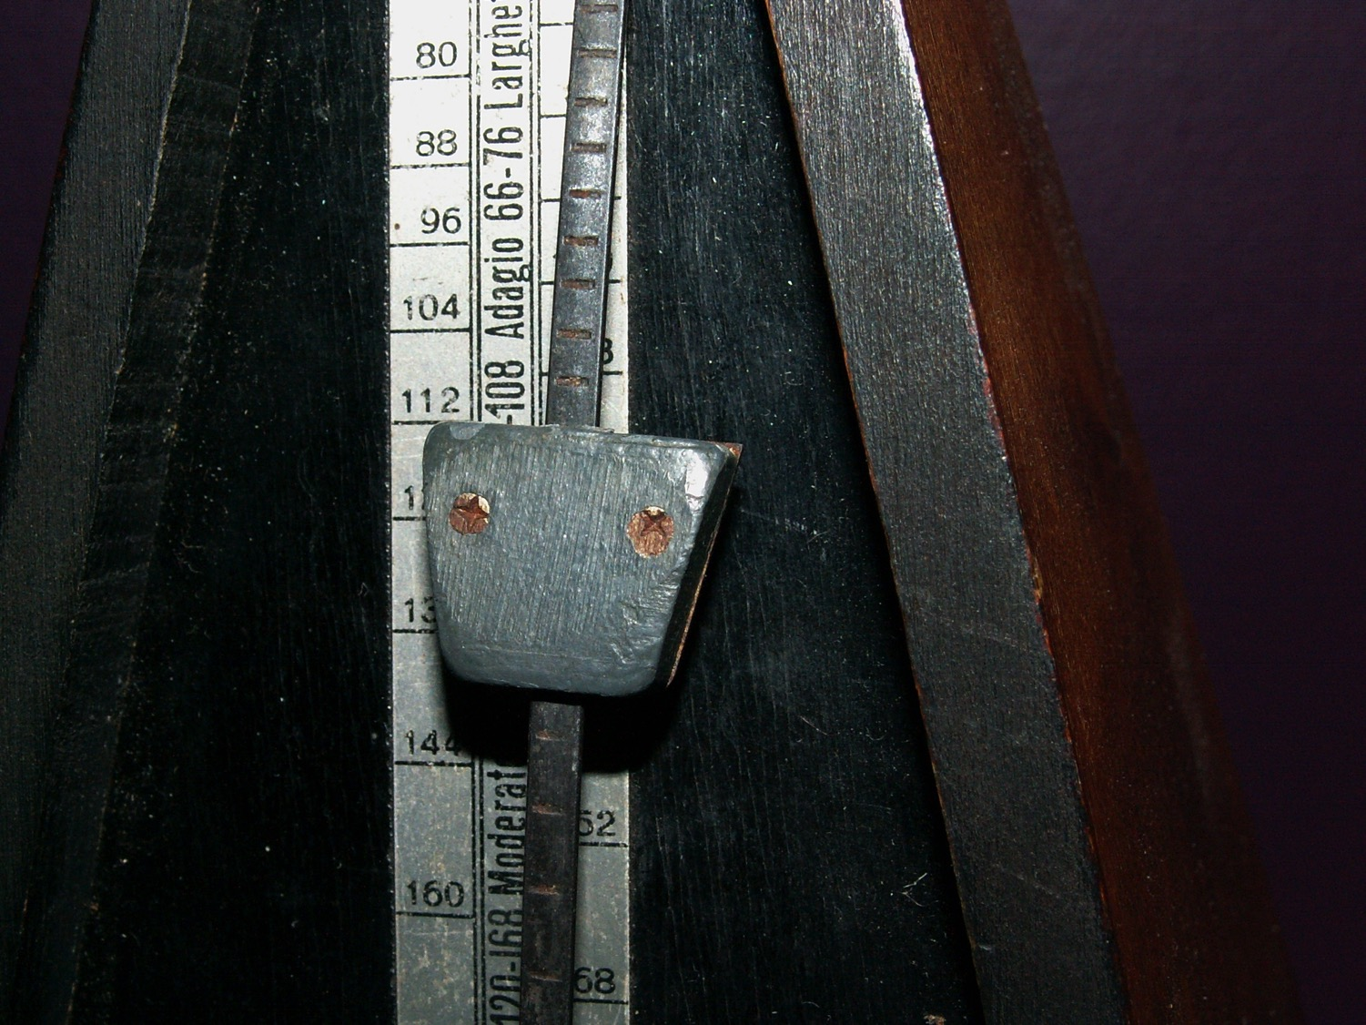
From NoSQL to NewSQL

Slide 39

The NoSQL discussion has nothing to do with SQL
Michael Stonebraker
Notes:
Series of blog posts in CACM

Slide 40
The NoSQL Performance Argument
I use MySQL to store my data
MySQL’s performance isn’t adequate
Partitioning my data across multiple sites is hard!
I don’t want to pay license fees for an enterprise RDBMS
∴
NoSQL is the way to go!

Slide 41
The NoSQL Performance Argument
Transaction cost in OLTP database consists largely of:
Logging (write to database, write to log)
Locking (recording locks in lock table)
Latching (updating shared data structure: B-trees, lock table, etc)
Buffer Management (buffer pool containing cached disk pages)
“The single-node performance of a NoSQL, disk-based, non-ACID, multithreaded system is limited to be a modest factor faster than a well-designed stored-procedure SQL OLTP engine” – the overhead isn’t due to SQL

Slide 42
NoSQL in the Enterprise
No ACID equals No Interest
Stored data is mission critical, inconsistency is dangerous
A Low-Level Query Language is Death
Record-at-a-time processing (c.f. IMS, CODASYL) require far greater programming effort - declarative languages like SQL are preferable
NoSQL means No Standards
Many different NoSQL databases, each with a different interface, data model, etc – how do you migrate from one to another?

Slide 43




Tick-tock, tick-tock...
...and back to relational databases again!
NewSQL
The scale-out OLTP performance of NoSQL...
...with the SQL support and ACID guarantees of RDBMS

Slide 44
Further Reading

Slide 45
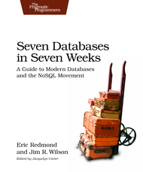
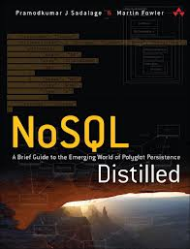
Some further reading...
The structure/content of these slides are covered in greater depth in:
“Seven Databases in Seven Weeks”
- Eric Redmond
“NoSQL Distilled”
- Martin Fowler
Mike Stonebraker’s blogs for CACM

Slide 46
… and some watching!
“Introduction to NoSQL” – Martin Fowler @ goto; 2012 http://www.youtube.com/watch?v=qI_g07C_Q5I
“The People vs. NoSQL Databases” – Panel Discussion @ goto; 2012 http://www.youtube.com/watch?v=191kCkNya5Q (NSWF language)
“MongoDB: It’s Not Just About Big Data” – Will Shulman http://www.youtube.com/watch?v=b1BZ9YFsd2o

